Slide 1


SLM-Based Agentic Coding Engine
Hania Khan & Hamna Asif

Slide 2
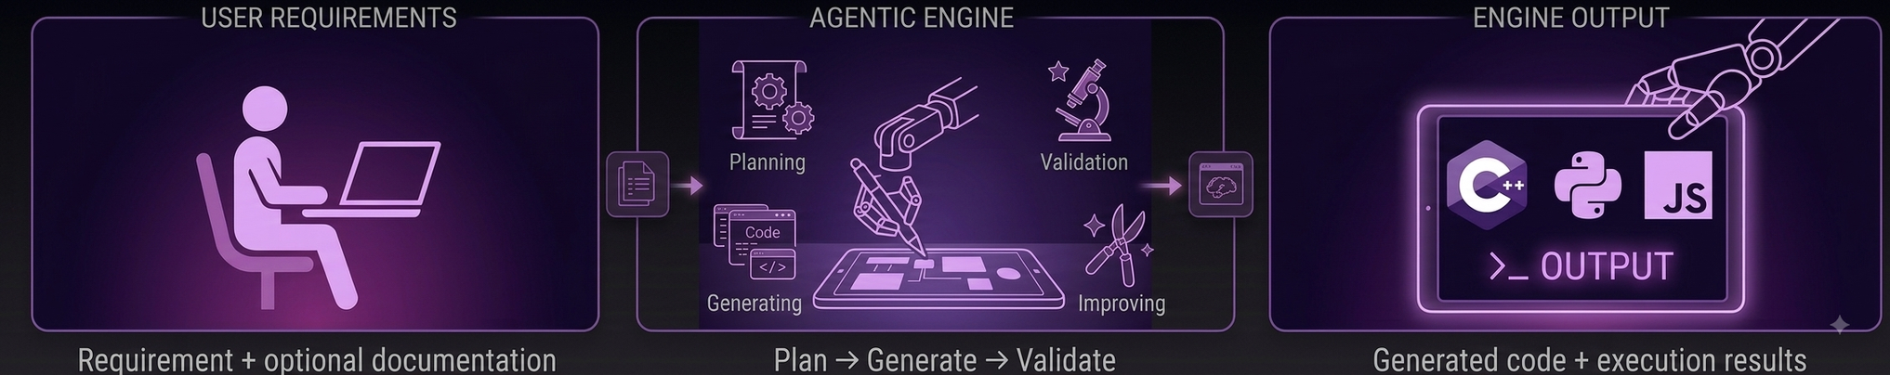
Goal
Turn a natural-language coding requirement into working code.
The system uses Small Language Models (SLMs) with an agentic workflow.
Agents reason, retrieve relevant documentation, generate code, validate results, and iterate when needed.

Slide 3
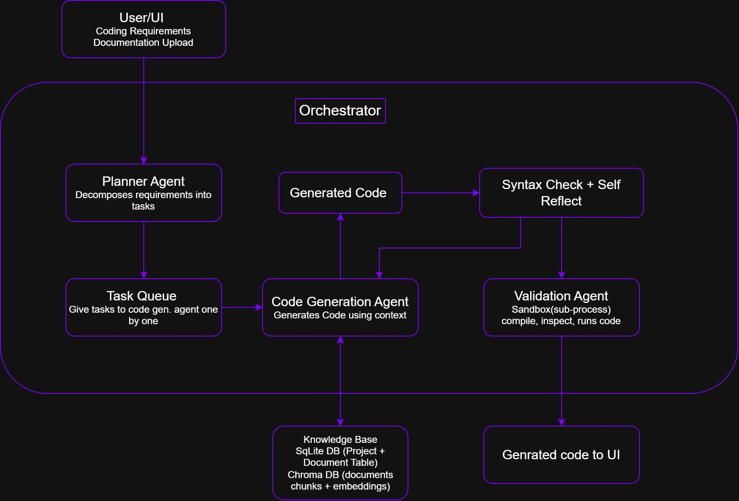




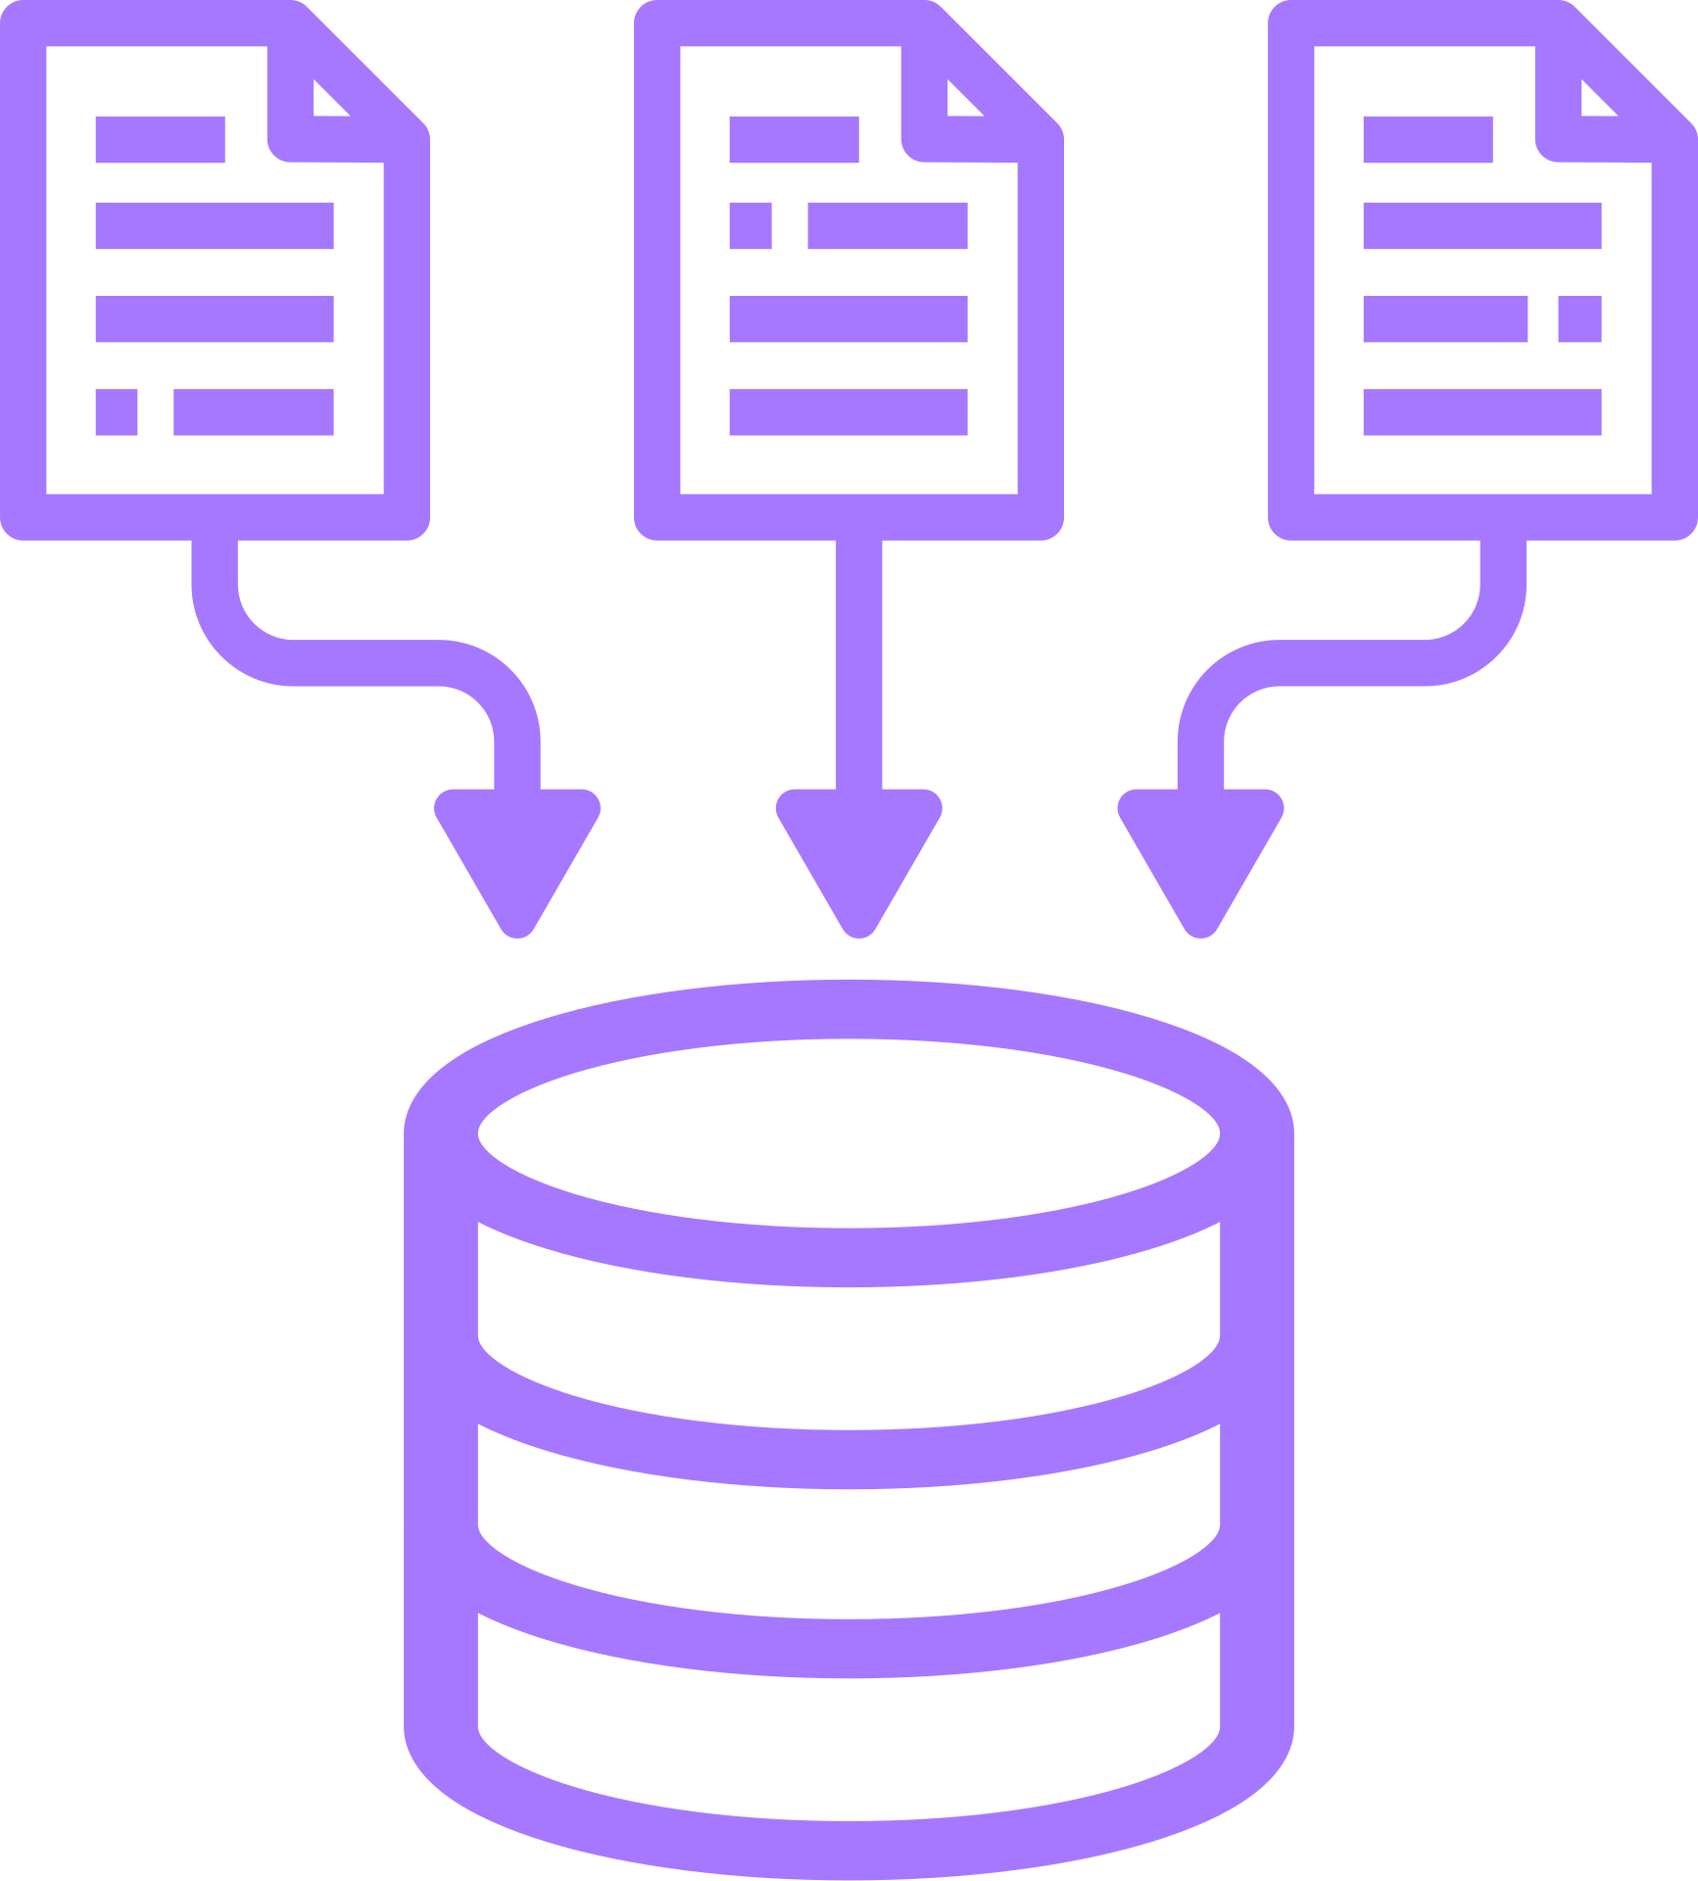

System Architecture
The orchestrator coordinates specialized agents through an iterative workflow

Slide 4
Live Demo
Let’s see it in action.

